Slide 1
Cornerstone City Church Peninsula Plus Community Hoo Are Ya 03-04-2022

Slide 2
Count Your Blessings
CCLI Song # 40416
© Words: Public Domain
Music: Public Domain
For use solely with the SongSelect® Terms of Use. All rights reserved. www.ccli.com
CCLI Licence No. 33265

Slide 3
1/1
Count your blessings
Name them one by one
Count your blessings
See what God has done Count your blessings
Name them one by one
And it will surprise you what the Lord has done

Slide 4
Million Little Miracles
CCLI Song # 7171580
Brandon Lake | Chris Brown | Steven Furtick
© 2021 Music by Elevation Worship Publishing (Admin. by Essential Music Publishing LLC)
Bethel Music Publishing (Admin. by Song Solutions)
Brandon Lake Music (Admin. by Song Solutions)
Maverick City Publishing Worldwide (Admin. by Song Solutions)
For use solely with the SongSelect® Terms of Use. All rights reserved. www.ccli.com
CCLI Licence No. 33265

Slide 5
1/7
All my life I've been carried by grace
Don't ask me how 'cause I can't explain
It's nothing short of a miracle I'm here
I've got some blessings that I don't deserve
I've got some scars but that's how you learn
It's nothing short of a miracle I'm here

Slide 6
2/7
I think it over and it doesn't add up
I know it comes from above

Slide 7
3/7
(I've got) miracles on miracles
A million little miracles
Miracles on miracles
Count your miracles
1-2-3-4 I can't even count 'em all

Slide 8
4/7
You held me steady so I wouldn't give up
You opened doors that nobody could shut
I hope I never get over what You've done
I wanna live with an open heart
I wanna live like I know who You are
I hope I never get over what You've done

Slide 9
5/7
It's not coincidence and it's not luck
I know it comes from above

Slide 10
6/7
(I've got) miracles on miracles
A million little miracles
Miracles on miracles
Count your miracles
1-2-3-4 I can't even count 'em all

Slide 11
7/7
I can't even I can't even count 'em all
I can't even I can't even count 'em all
I can't even I can't even count 'em all 1-2-3-4 I can't even count 'em all

Slide 12
Every Praise
CCLI Song # 6623483
Hezekiah Walker | John David Bratton
© 2013 Davo Pavo Music (Admin. by BMG Rights Management GmbH)
Li'l Eva Music (Admin. by Capitol CMG Publishing)
Luv Ki Publishing (Admin. by Capitol CMG Publishing)
For use solely with the SongSelect® Terms of Use. All rights reserved. www.ccli.com
CCLI Licence No. 33265

Slide 13
1/2
Every praise is to our God
Every word of worship with one accord
Every praise every praise is to our God
Sing hallelujah to our God
Glory hallelujah is due our God
Every praise every praise is to our God

Slide 14
2/2
God my Saviour
God my Healer
God my Deliverer
Yes He is yes He is
(Yes He is yes He is)

Slide 15
Mighty to Save
CCLI Song # 4591782
Ben Fielding | Reuben Morgan
© 2006 Hillsong Music Publishing Australia (Admin. by Hillsong Music Publishing UK)
For use solely with the SongSelect® Terms of Use. All rights reserved. www.ccli.com
CCLI Licence No. 33265

Slide 16
1/4
Ev’ryone needs compassion
Love that's never failing
Let mercy fall on me
Ev’ryone needs forgiveness
The kindness of a Saviour
The hope of nations

Slide 17
2/4
Saviour He can move the mountains
My God is mighty to save
He is mighty to save
Forever Author of salvation
He rose and conquered the grave
Jesus conquered the grave

Slide 18
3/4
So take me as You find me
All my fears and failures
Fill my life again
I give my life to follow
Ev’rything I believe in
Now I surrender

Slide 19
4/4
Shine your light and let the whole world see
We're singing
For the glory of the risen King
Jesus
Shine your light and let the whole world see
We're singing
For the glory of the risen King

Slide 20
Wide as the Sky
CCLI Song # 7000697
Jonas Myrin | Kristian Stanfill | Matt Redman
© 2013 Said And Done Music (Admin. by Integrity Music Ltd)
sixsteps Music (Admin. by Integrity Music Ltd)
Thankyou Music (Admin. by Integrity Music Ltd)
worshiptogether.com songs (Admin. by Integrity Music Ltd)
Atlas Mountain Songs (Admin. by SHOUT! Music Publishing UK)
For use solely with the SongSelect® Terms of Use. All rights reserved. www.ccli.com
CCLI Licence No. 33265

Slide 21
1/3
Hands up hearts open wide as the sky
We lift You high we lift You high
Hands up hearts open wide as we cry
God we lift Your name high
(REPEAT)

Slide 22
2/3
Let all the other names fade away
Let all the other names fade away
Until there's only You
Let all the other names fade away
Jesus take Your place
Jesus take Your place
(REPEAT)

Slide 23
3/3
Our God we lift You high We lift You high
Hands up God we lift Your name high
Our God we lift You high
We lift You high
Hands up God we lift Your name high
(REPEAT)

Slide 24
Your Name
CCLI Song # 4611679
Glenn Packiam | Paul Baloche
© 2006 Integrity Worship Music (Admin. by Integrity Music Ltd)
Integrity's Hosanna! Music (Admin. by Integrity Music Ltd)
For use solely with the SongSelect® Terms of Use. All rights reserved. www.ccli.com
CCLI Licence No. 33265

Slide 25
1/4
As morning dawns and evening fades
You inspire songs of praise
That rise from earth to touch Your heart
And glorify Your Name

Slide 26
2/4
Your Name is a strong and mighty tower
Your Name is a shelter like no other
Your Name let the nations sing it louder
'Cause nothing has the power to save
But Your Name

Slide 27
3/4
Jesus in Your Name we pray
Come and fill our hearts today
Lord give us strength to live for You
And glorify Your Name

Slide 28
4/4
Your Name is a strong and mighty tower
Your Name is a shelter like no other
Your Name let the nations sing it louder
'Cause nothing has the power to save
But Your Name

Slide 30


Slide 31


Slide 32


Slide 33


Slide 34
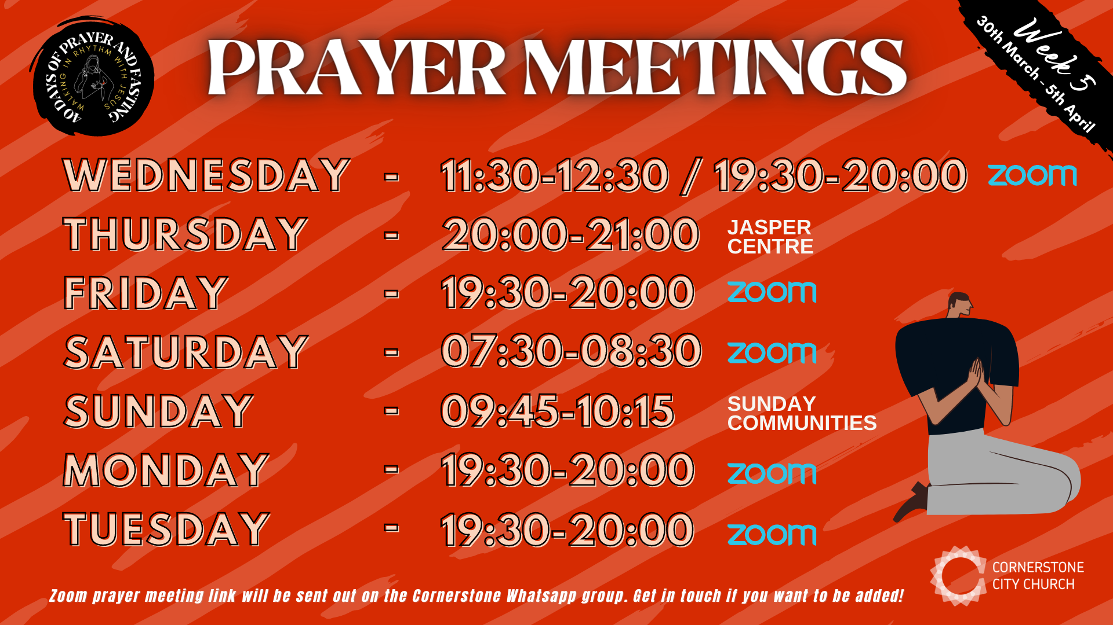

Slide 35


Slide 36


Slide 37


Slide 38


Slide 39
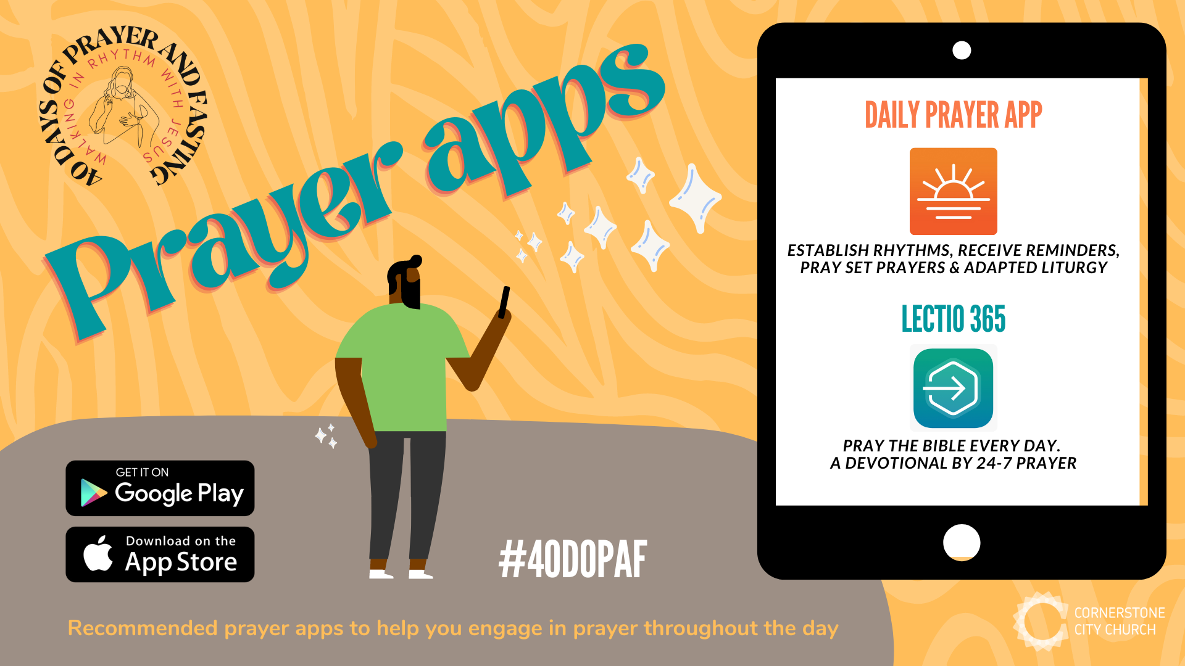

Slide 40


Slide 41


Slide 42
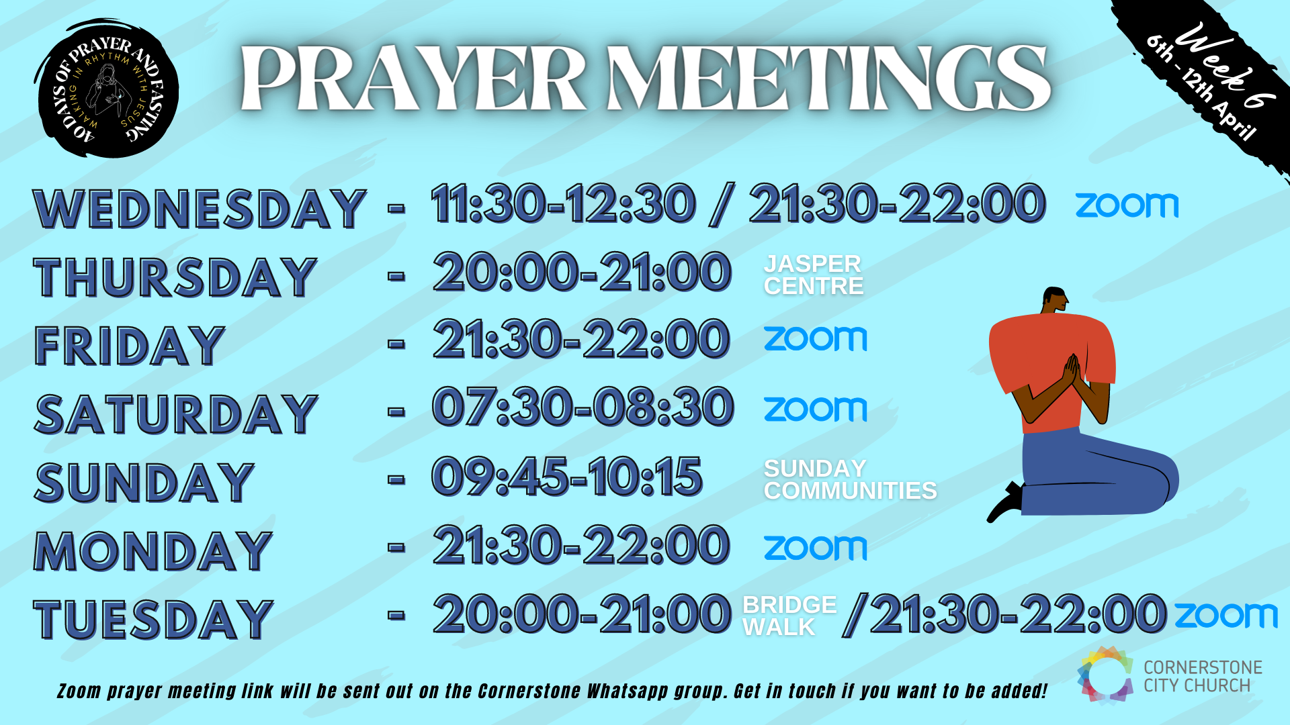

Slide 43


Slide 44


Slide 45


Slide 46


Slide 47
Worthy Of it All
CCLI Song # 6280644
David Brymer | Ryan Hall
© 2012 Common Hymnal Publishing (Admin. by Integrity Music Ltd)
Innerland (Admin. by Integrity Music Ltd)
Underground Treasure (Admin. by Integrity Music Ltd)
Wayfinder Music (Admin. by Integrity Music Ltd)
For use solely with the SongSelect® Terms of Use. All rights reserved. www.ccli.com
CCLI Licence No. 33265

Slide 48
1/3
All the saints and angels
Bow before Your throne
All the elders cast their crowns
Before the Lamb of God and sing

Slide 49
2/3
You are worthy of it all
You are worthy of it all
For from You are all things
And to You are all things
You deserve the glory

Slide 50
3/3
Day and night,
Night and day,
Let incense arise
(X4)
Day and night
Night and day

